Slide 1
TGIP Episode 016
Backlog vs StorageSize

Slide 2
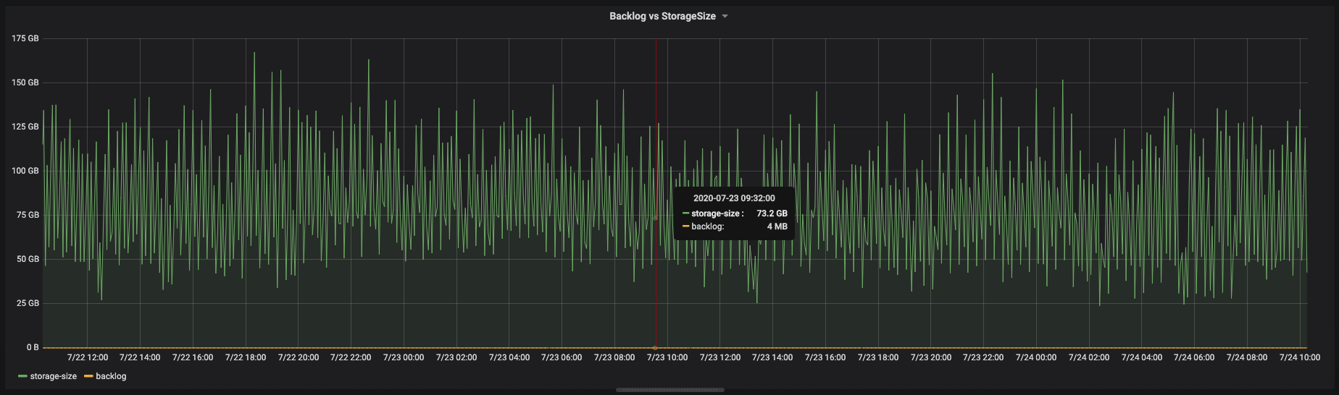
Question #1
Q1: Without retention settings, why storage size is much larger than msg backlog size?

Slide 3
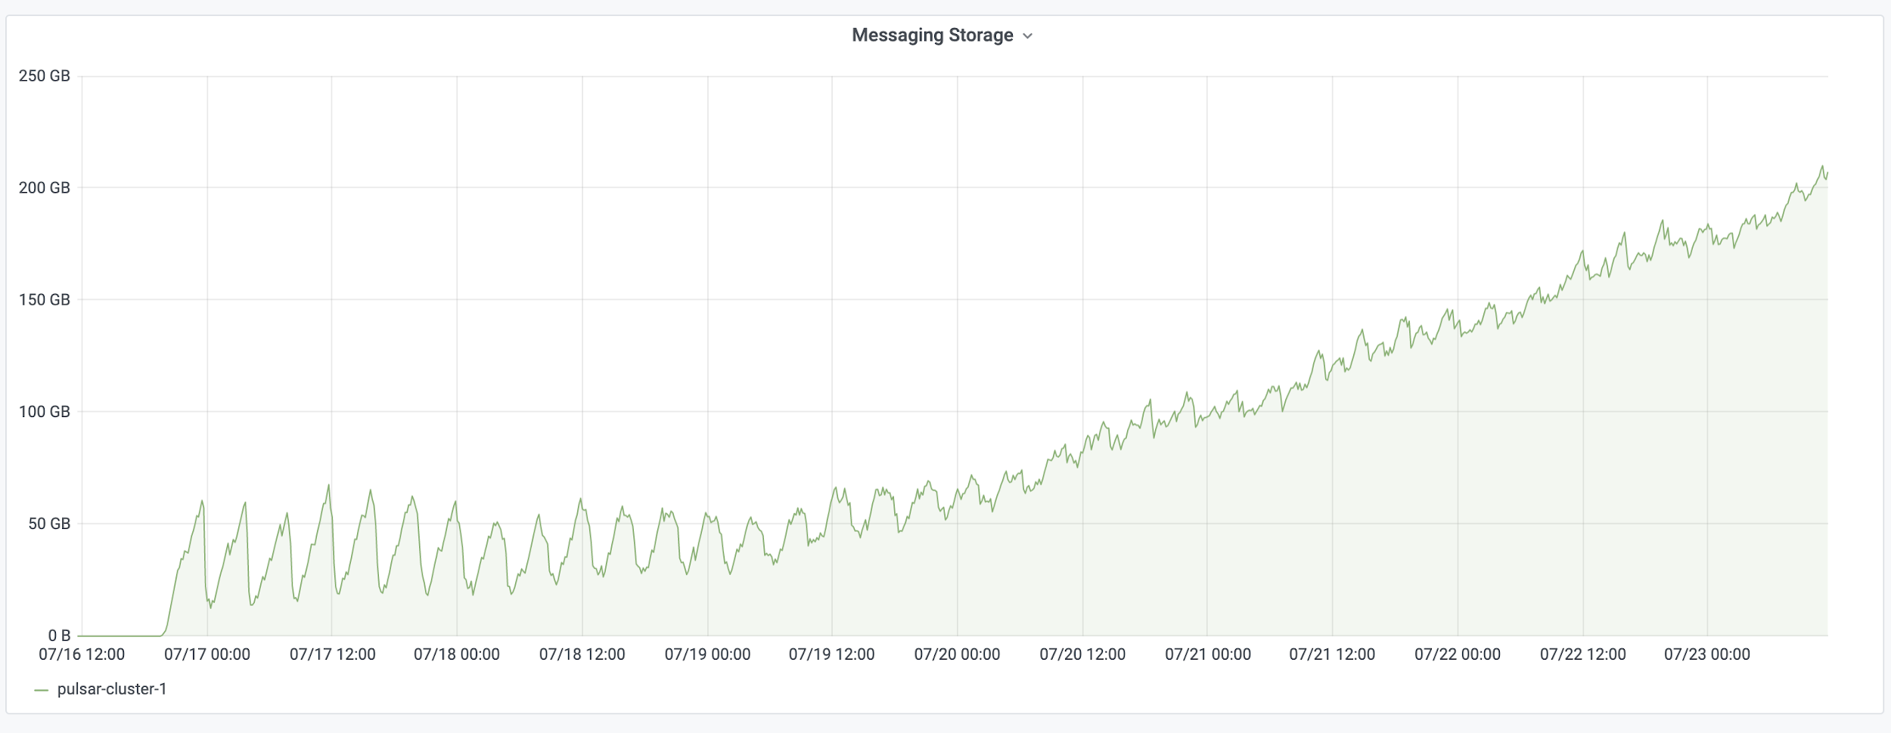
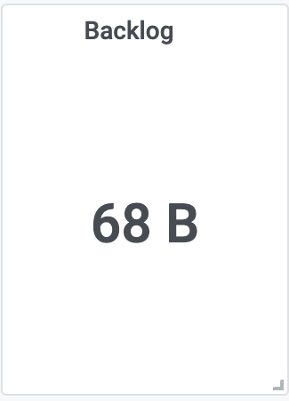
Question #2
Q2: Why does storage size keep growing while the msg backlog size is small?

Slide 4
Question #3
Q3: What is the expected behavior when combining 100GB retention policy, 1GB backlog quota and a consumer with SubscriptionInitialPosition.Earliest setting?
https://github.com/apache/pulsar/issues/7500

Slide 5
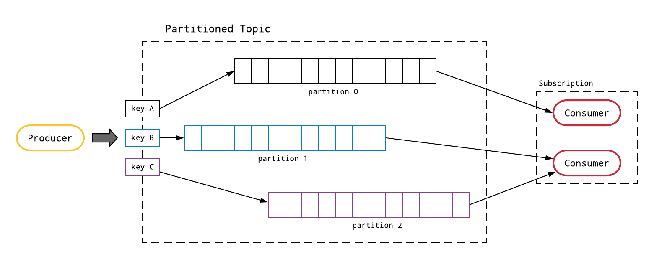
Topic & Subscription

Slide 6
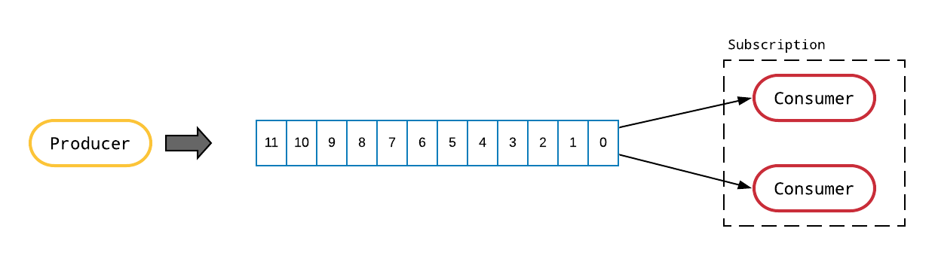
Topic Partition

Slide 7
Storage model
#1 msgs are stored ONCE in a distributed log for each topic partition

Slide 8
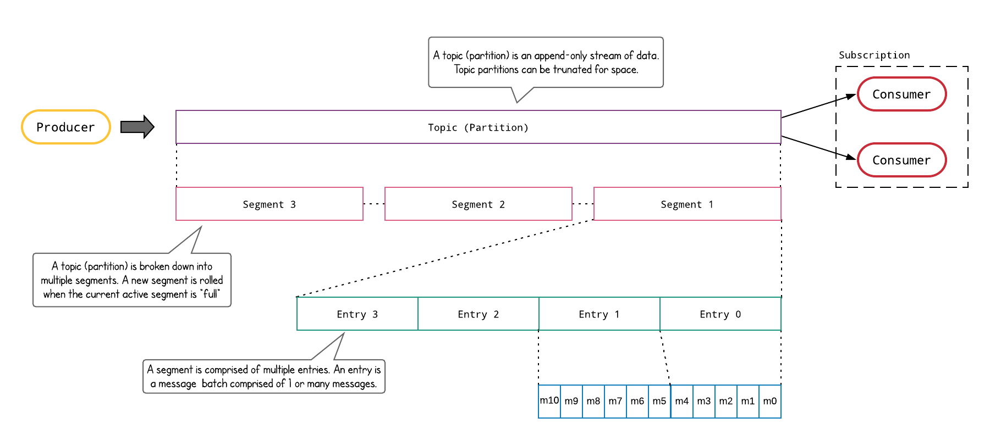
Topic Partition Impl

Slide 9
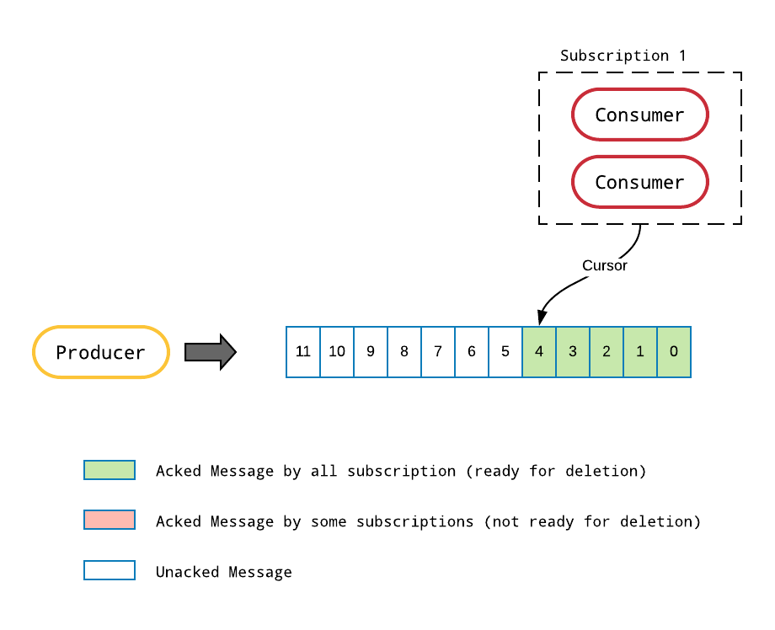
Subscription & Cursor

Slide 10
Storage model
#1 Msgs are stored ONCE in a distributed log for each topic partition #2 Cursor stores the consumption state of a subscription

Slide 11
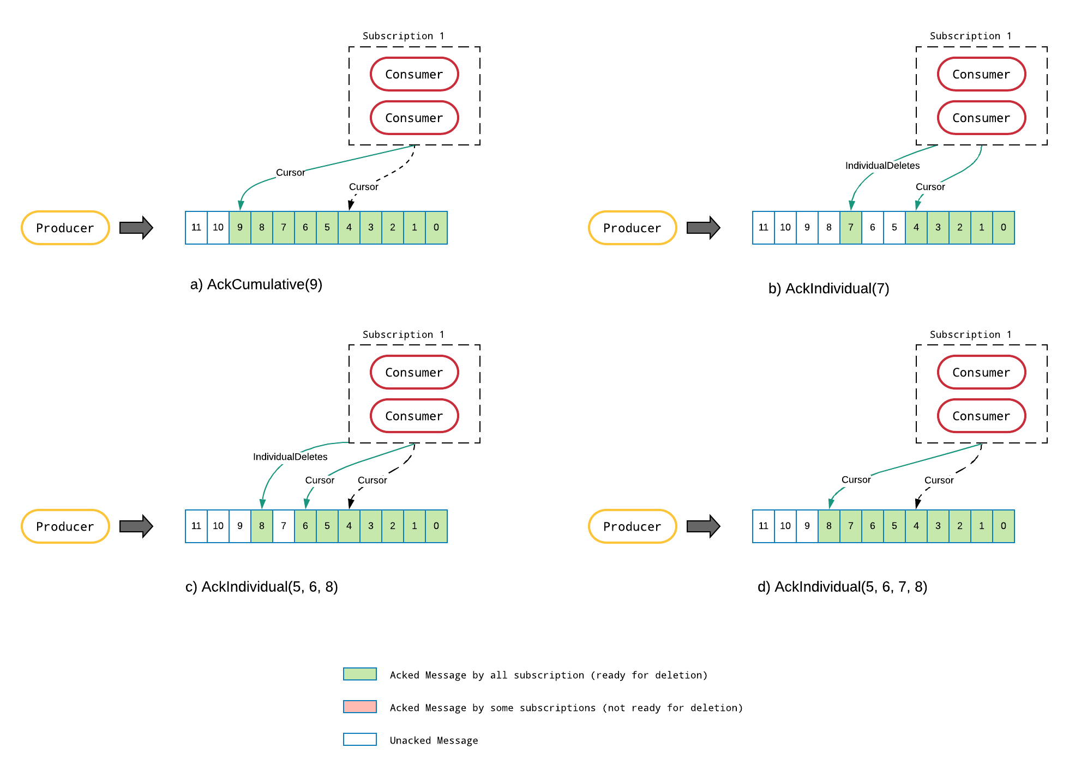
Acknowledgment

Slide 12
Storage model
#1 Msgs are stored ONCE in a distributed log for each topic partition #2 Cursor stores the consumption state of a subscription #3 Cursor == Offset + Individual Deletes. Acks update cursor.

Slide 13
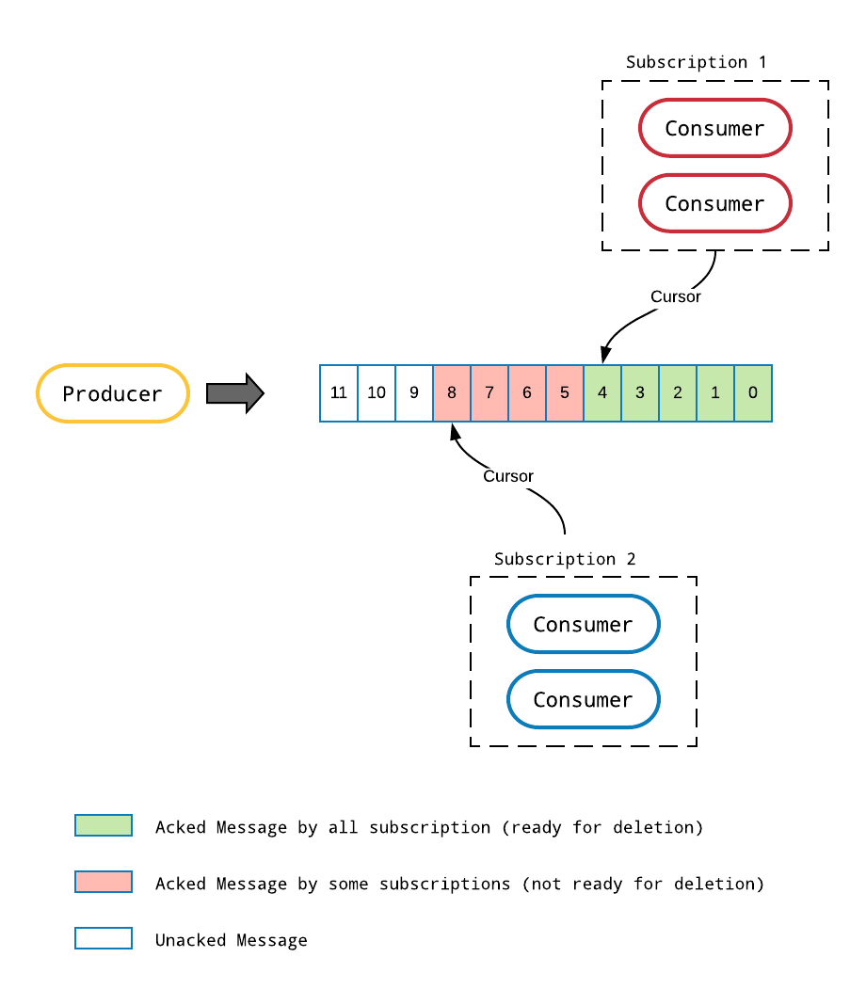
Multi Subscriptions

Slide 14
Storage model
#1 Msgs are stored ONCE in a distributed log for each topic partition #2 Cursor stores the consumption state of a subscription #3 Cursor == Offset + Individual Deletes. Acks update cursor. #4 Msgs are READY to delete after subscriptions ack them.

Slide 15
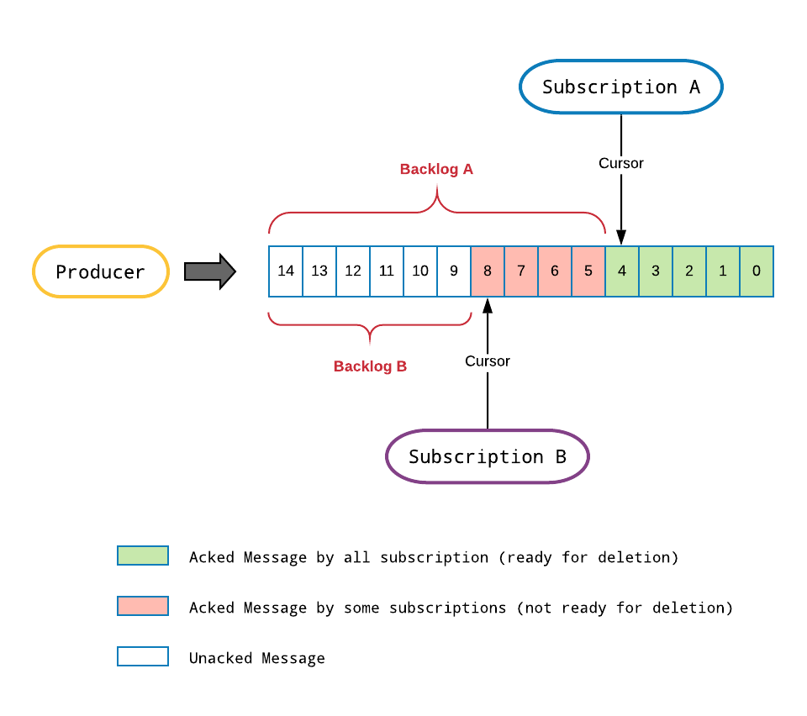
Backlog
Subscription Backlog: All the unacked messages of a subscription
Topic Backlog: The backlog of the slowest subscription

Slide 16
Backlog Stats
backlogSize: The total bytes of unacked messages
msgBacklog: The total number of unacked entries
Use `bin/pulsar-admin topics stats` to query the statistics of a topic
https://github.com/apache/pulsar/issues/7484

Slide 17
Storage model
#1 Msgs are stored ONCE in a distributed log for each topic partition #2 Cursor stores the consumption state of a subscription #3 Cursor == Offset + Individual Deletes. Acks update cursor. #4 Msgs are READY to delete after subscriptions ack them. #5 The unacked msgs are “kept” in a subscription backlog.

Slide 18
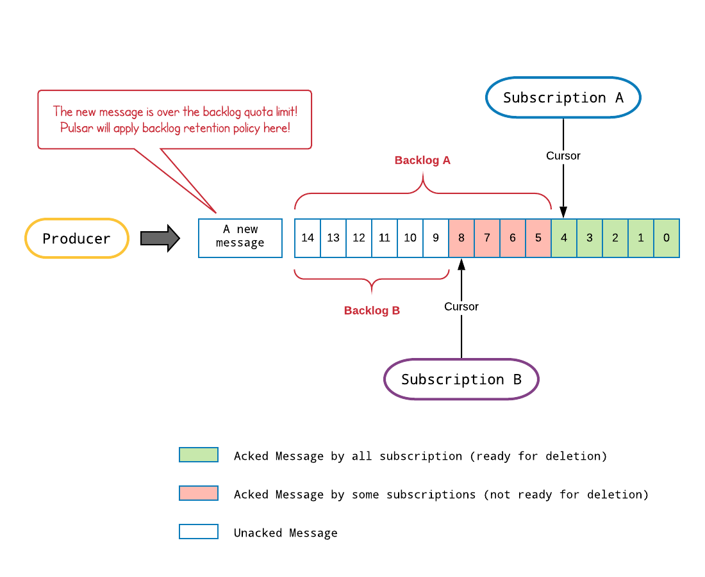
Backlog Quota

Slide 19
Backlog Retention Policy
Producer_request_hold
Producer_exception
consumer_backlog_eviction

Slide 20
Backlog Quota Config
Cluster config
backlogQuotaDefaultLimitGB
backlogQuotaDefaultRetentionPolicy
backlogQuotaCheckEnabled
Namespace policy
Usage: set-backlog-quota [options] tenant/namespace
Options:
* -l, --limit
Size limit (eg: 10M, 16G)
* -p, --policy
Retention policy to enforce when the limit is reached. Valid options are:
[producer_request_hold, producer_exception, consumer_backlog_eviction]

Slide 21
Storage model
#1 Msgs are stored ONCE in a distributed log for each topic partition #2 Cursor stores the consumption state of a subscription #3 Cursor == Offset + Individual Deletes. Acks update cursor. #4 Msgs are READY to delete after subscriptions ack them. #5 The unacked msgs are “kept” in a subscription backlog. #6 Backlog quota sets a CAP on unacked messages.

Slide 22
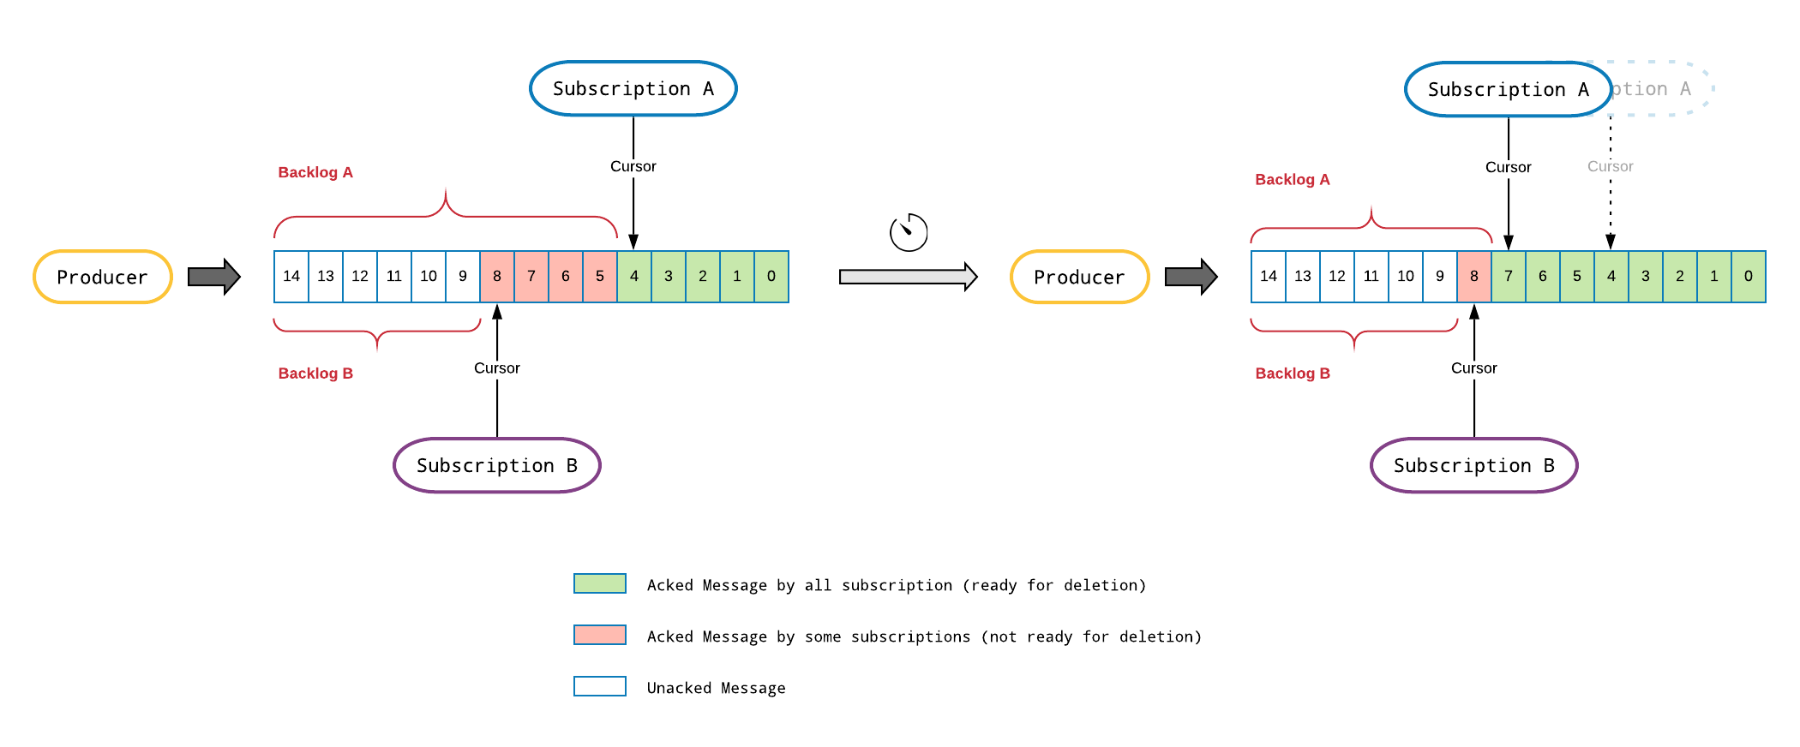
TTL
TTL defines the amount of time a message is allowed to stay in the unacknowledged state

Slide 23
TTL Config
Cluster config
ttlDurationDefaultInSeconds
Namespace policy
Set Message TTL for a namespace
Usage: set-message-ttl [options] tenant/namespace
Options:
* --messageTTL, -ttl
Message TTL in seconds
Default: 0

Slide 24
Storage model
#1 Msgs are stored ONCE in a distributed log for each topic partition #2 Cursor stores the consumption state of a subscription #3 Cursor == Offset + Individual Deletes. Acks update cursor. #4 Msgs are READY to delete after subscriptions ack them. #5 The unacked msgs are “kept” in a subscription backlog. #6 Backlog quota sets a CAP on unacked messages. #7 TTL defines the time a msg can stay in the unacknowledged state

Slide 25
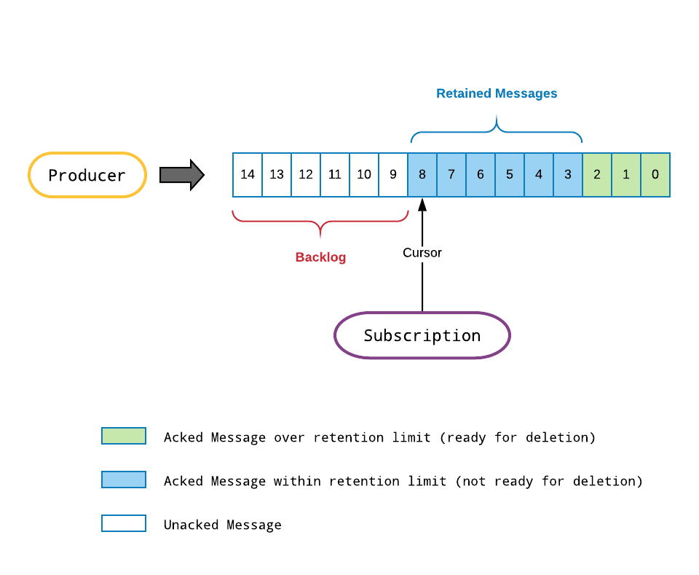
Retention
Retention Policy defines the amount of time acked messages would be kept before deletion

Slide 26
Retention Config
Cluster config
defaultRetentionTimeInMinutes
defaultRetentionSizeInMB
Namespace policy
Set the retention policy for a namespace
Usage: set-retention [options] tenant/namespace
Options:
* --size, -s
Retention size limit (eg: 10M, 16G, 3T). 0 or less than 1MB means no
retention and -1 means infinite size retention
* --time, -t
Retention time in minutes (or minutes, hours,days,weeks eg: 100m, 3h, 2d,
5w). 0 means no retention and -1 means infinite time retention

Slide 27
Storage model
#1 Msgs are stored ONCE in a distributed log for each topic partition #2 Cursor stores the consumption state of a subscription #3 Cursor == Offset + Individual Deletes. Acks update cursor. #4 Msgs are READY to delete after subscriptions ack them. #5 The unacked msgs are “kept” in a subscription backlog. #6 Backlog quota sets a CAP on unacked messages. #7 TTL defines the time a msg can stay in the unacknowledged state #8 Retention Policy defines how to handle acked messages

Slide 28
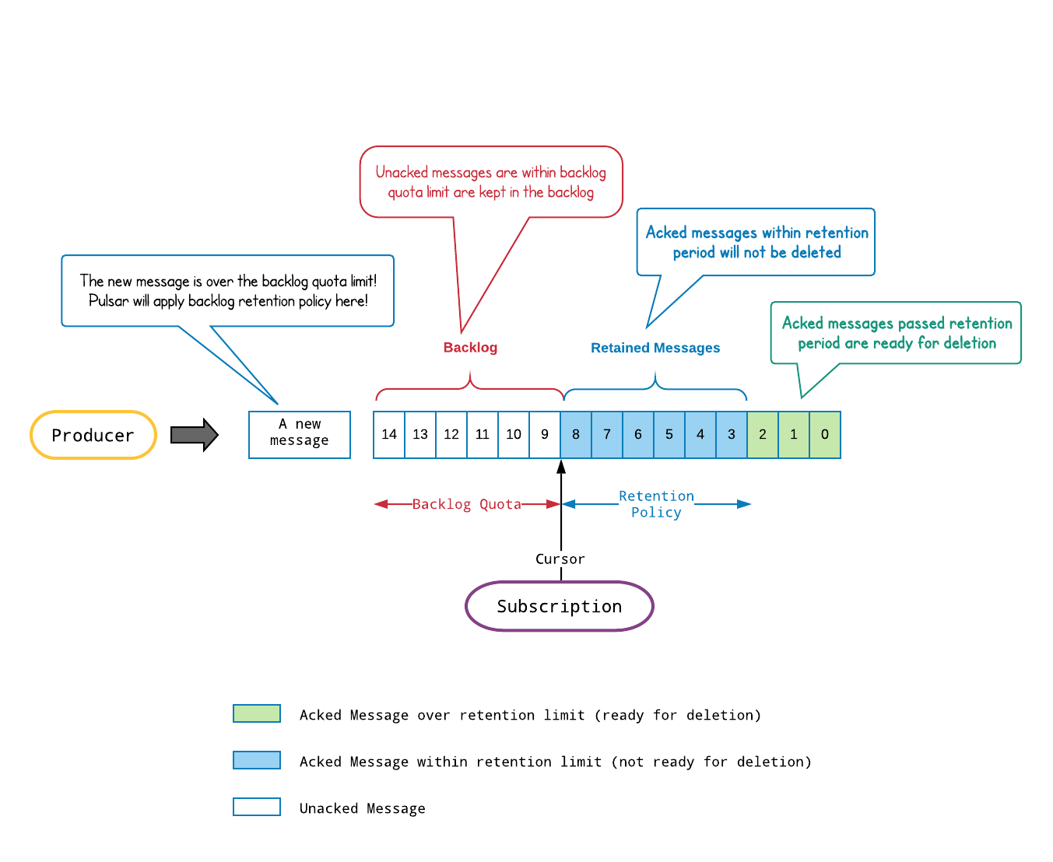
Put everything together

Slide 29
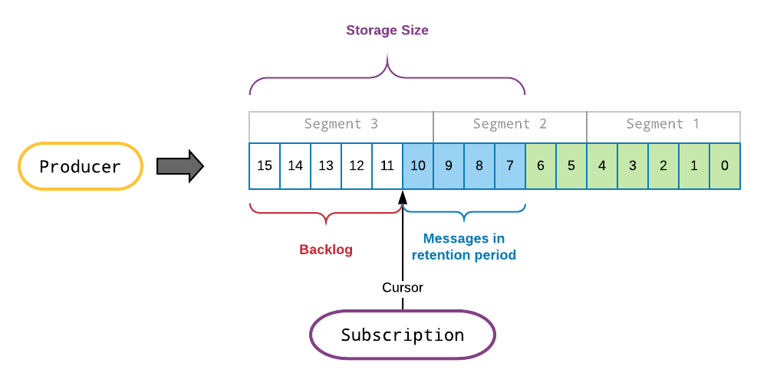
Storage Size
Storage Size is the total amount of data that are not DELETED.
Storage Size = Backlog Size + Retained Messages Size

Slide 30
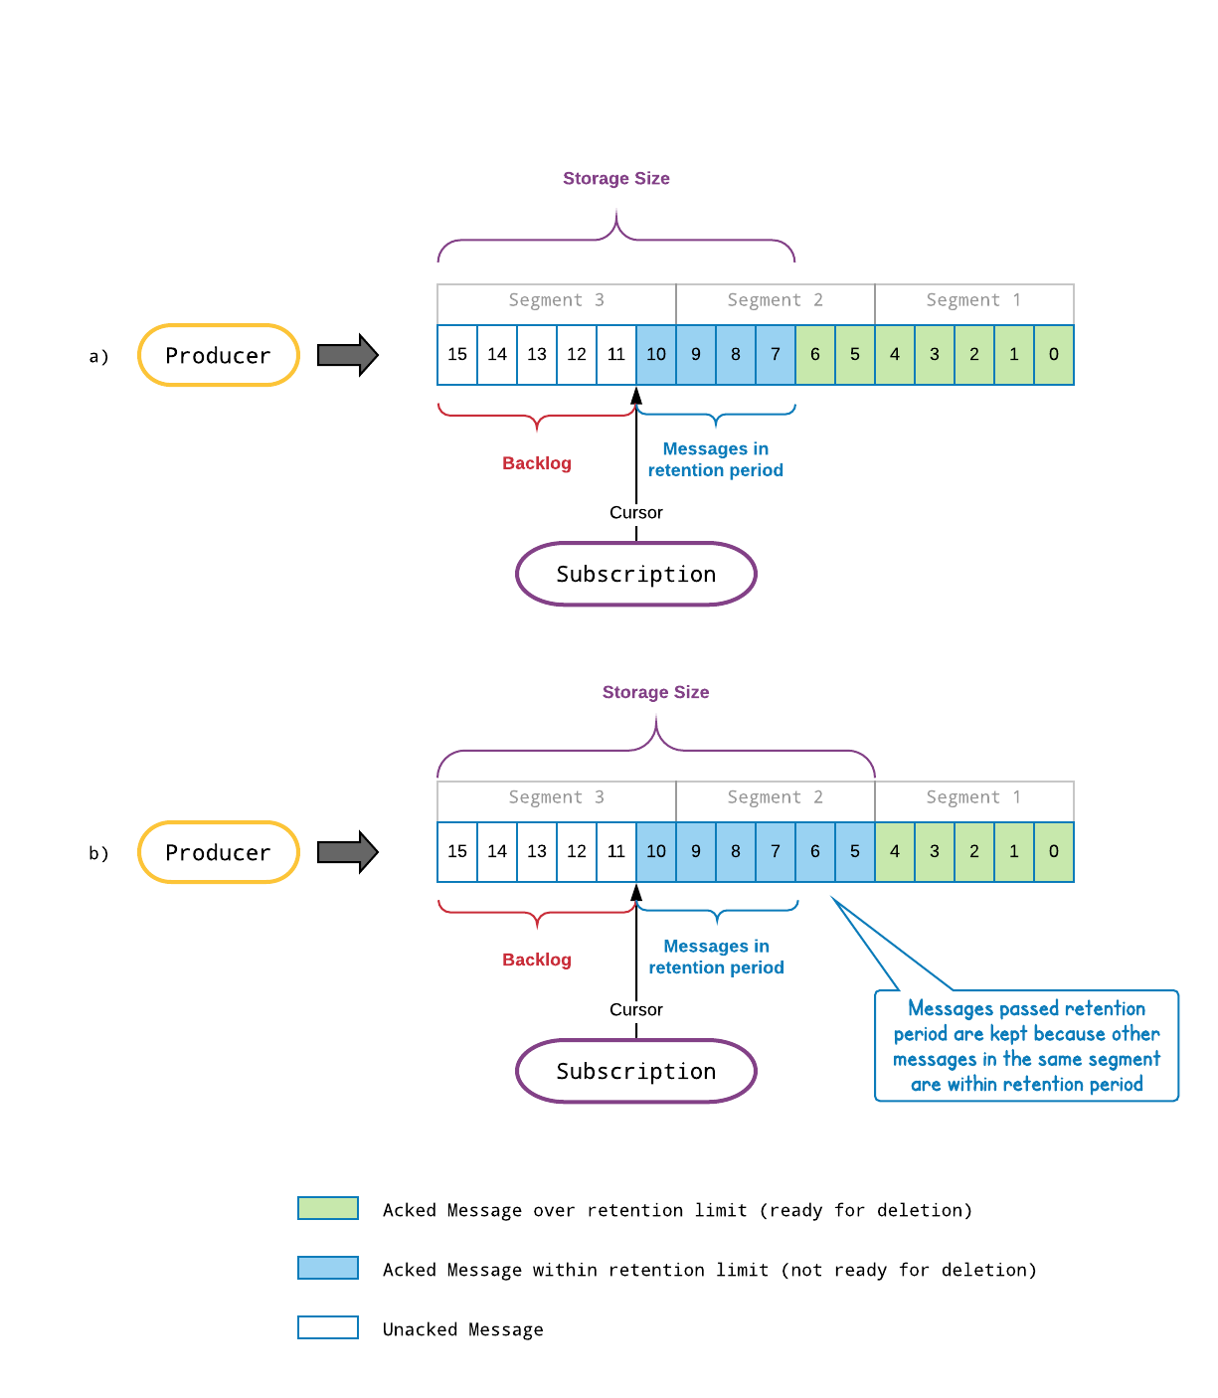
Storage Size
Messages are not deleted one by one
Messages are deleted segment by segment
Messages pass retention period are kept because other messages in the same segment are in retention period

Slide 31
Storage model
#1 Msgs are stored ONCE in a distributed log for each topic partition #2 Cursor stores the consumption state of a subscription #3 Cursor == Offset + Individual Deletes. Acks update cursor. #4 Msgs are READY to delete after subscriptions ack them. #5 The unacked msgs are “kept” in a subscription backlog. #6 Backlog quota sets a CAP on unacked messages. #7 TTL defines the time a msg can stay in the unacknowledged state #8 Retention Policy defines how to handle acked messages #9 Messages are deleted segment by segment (not individually)

Slide 32
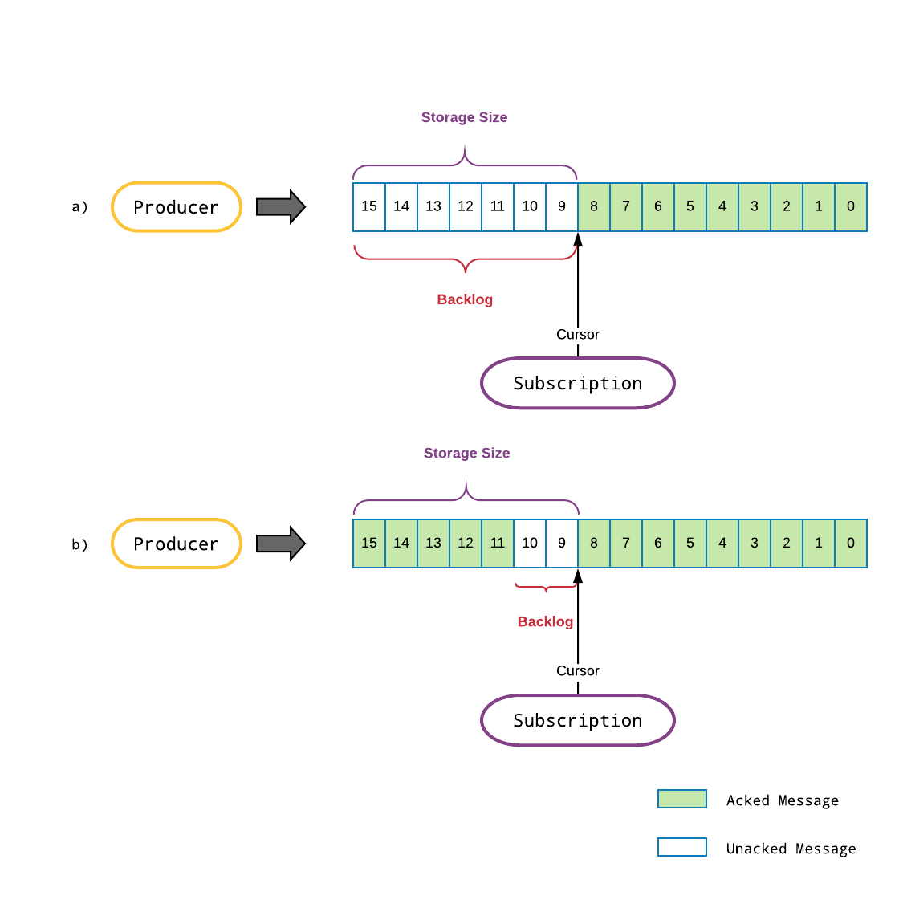
Msg Backlog vs Storage Size
#a backlog == storage size
#b storage size >> backlog

Slide 33
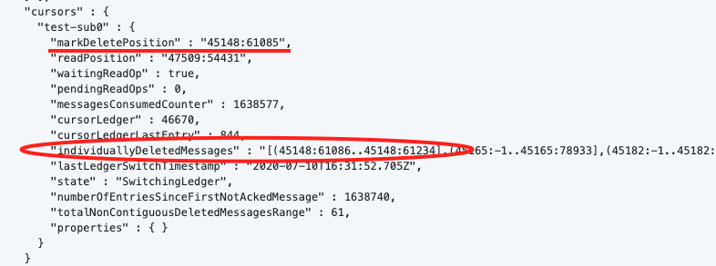
Troubleshooting
`pulsar-admin topics stats-internal`
The hole in `individuallyDeletedMessages` will cause storage size growing while backlog remains small
`pulsar-admin topics unload` to trigger redelivery
Set proper ackTimeout

Slide 34
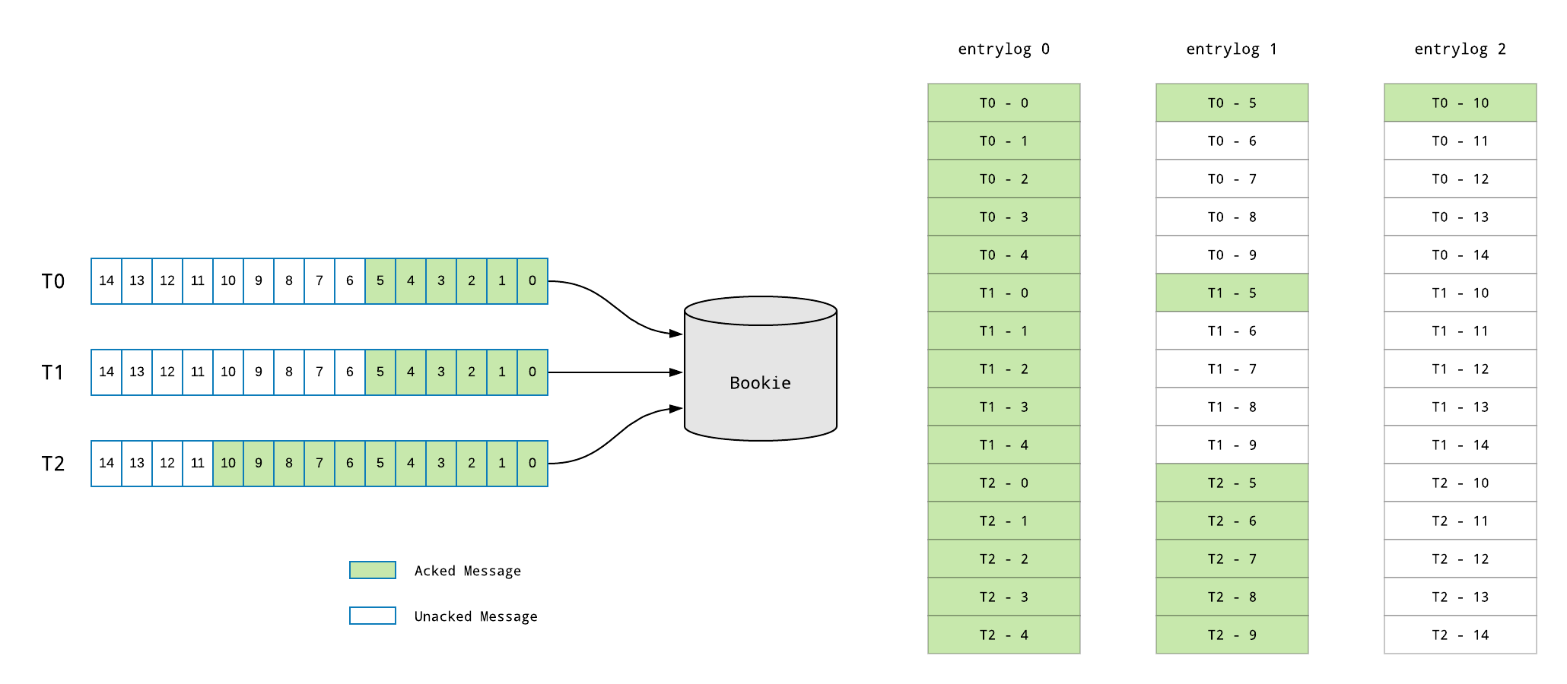
Storage Size vs Disk Usage

Slide 35
Storage model
#1 Msgs are stored ONCE in a distributed log for each topic partition #2 Cursor stores the consumption state of a subscription #3 Cursor == Offset + Individual Deletes. Acks update cursor. #4 Msgs are READY to delete after subscriptions ack them. #5 The unacked msgs are “kept” in a subscription backlog. #6 Backlog quota sets a CAP on unacked messages. #7 TTL defines the time a msg can stay in the unacknowledged state #8 Retention Policy defines how to handle acked messages #9 Messages are deleted segment by segment (not individually) #10 The disk space of DELETED msgs is reclaimed lazily

Slide 36
Go to production
Set backlog quota and policy
Set TTL policy
Set retention policy
Tune settings related to storage size
managedLedgerMinLedgerRolloverTimeMinutes
managedLedgerMaxLedgerRolloverTimeMinutes
managedLedgerMaxSizePerLedgerMbytes
Tune bookie GC settings
gcWaitTime
minorCompactionInterval
majorCompactionThreshold

